Slide 1
#perfMatters

Slide 2
About me
Twitter: @geekanamika
LinkedIn: https://www.linkedin.com/in/geekanamika/
Medium: https://medium.com/@anamikatripathi1601/
Github: https://github.com/geekanamika
Notes:
1. Android experience
2. Prior performance knowledge if yes which
3. applied it?
Performance playlist: https://www.youtube.com/playlist?list=PLWz5rJ2EKKc9CBxr3BVjPTPoDPLdPIFCE
Udacity course: https://in.udacity.com/course/android-performance--ud825

Slide 3
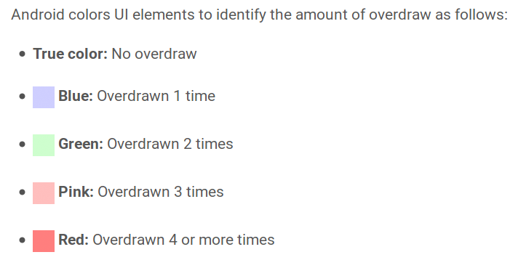
Overdraw
An app may draw the same pixel more than once within a single frame, an event called overdraw.
For example, if we have a bunch of stacked UI cards, each card hides a portion of the one below it.
However, the system still needs to draw even the hidden portions of the cards in the stack. This is because stacked cards are rendered according to the painter's algorithm: that is, in back-to-front order.
Notes:
How a view gets rendered to the Android application/screen?
Link for power-up examples : https://goo.gl/62sABj

Slide 4
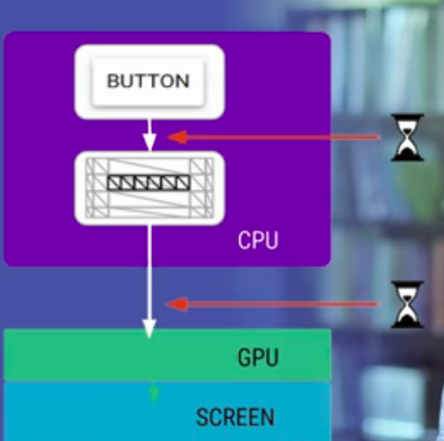
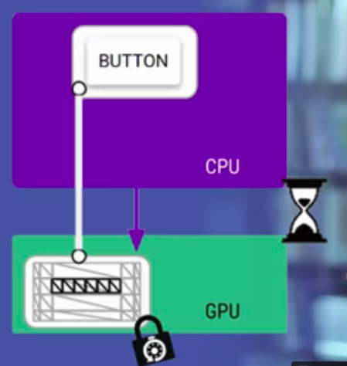
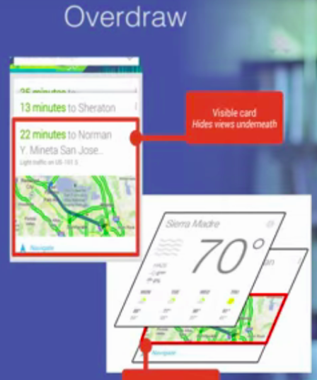
Reason
Notes:
Computer graphics?

Slide 5

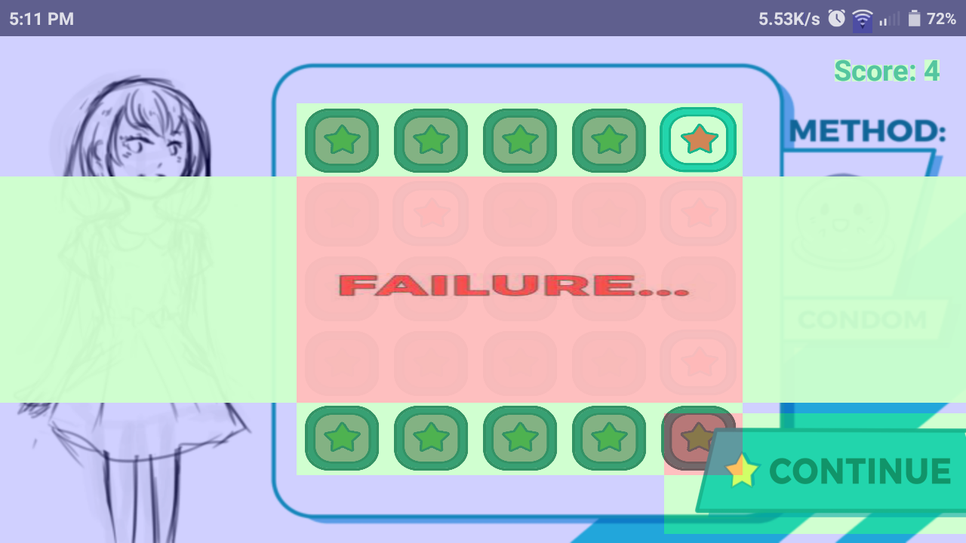
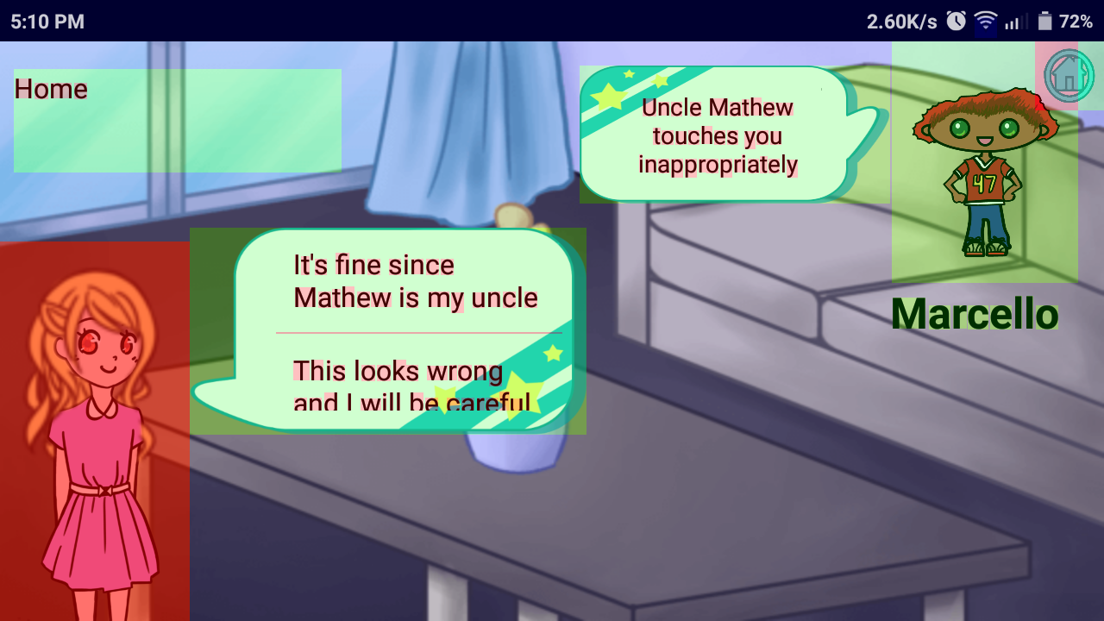
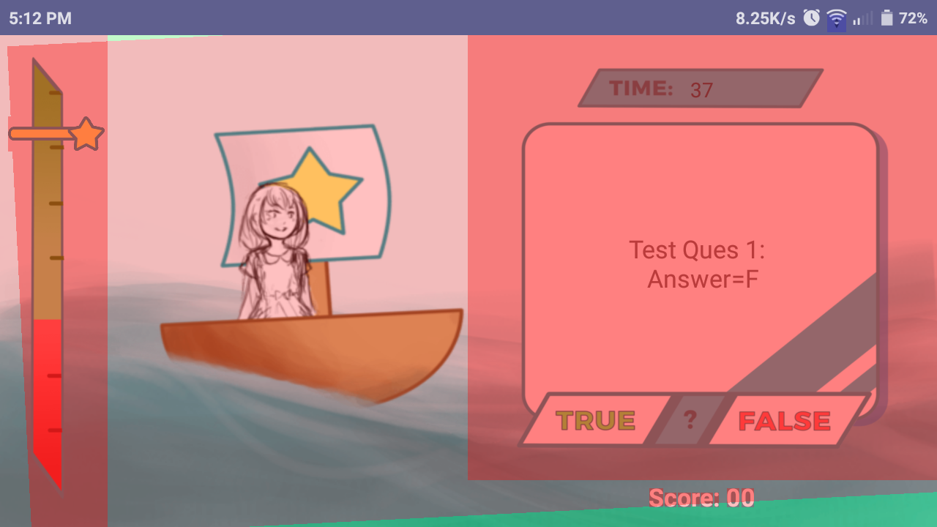
Overdraw

Slide 6
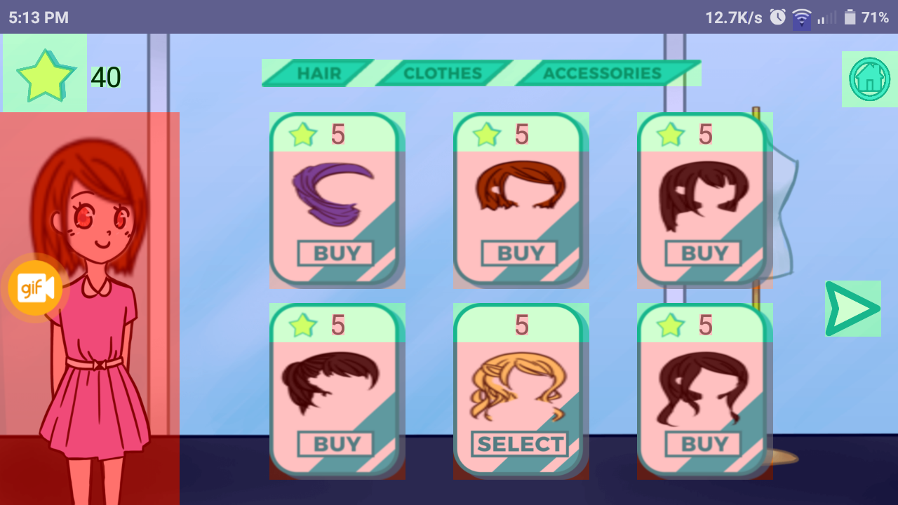

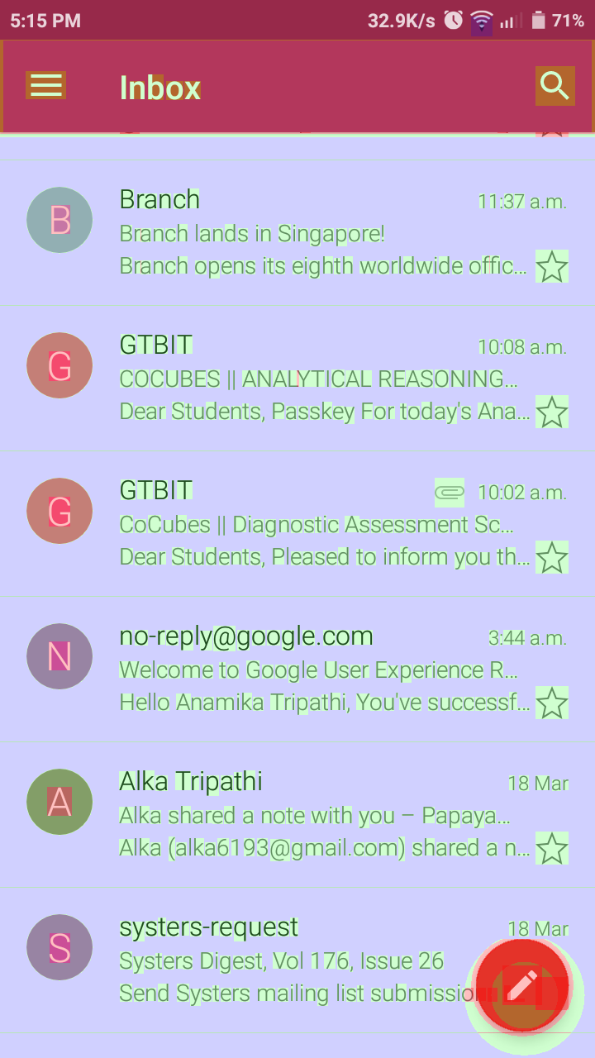
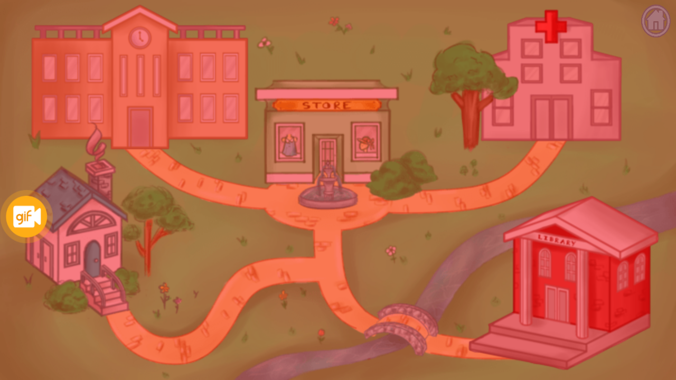
Notes:
Why does it happens?

Slide 7
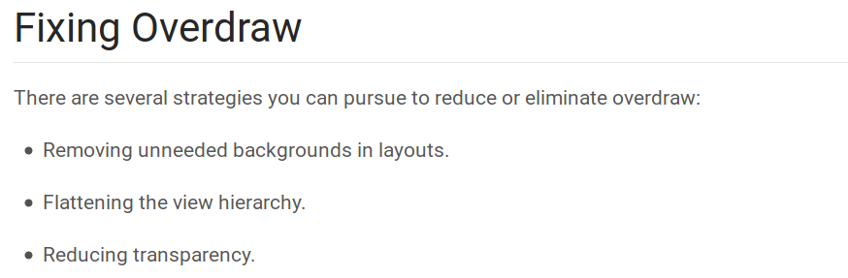
Notes:
How to flatten the view Hierarchy?

Slide 8
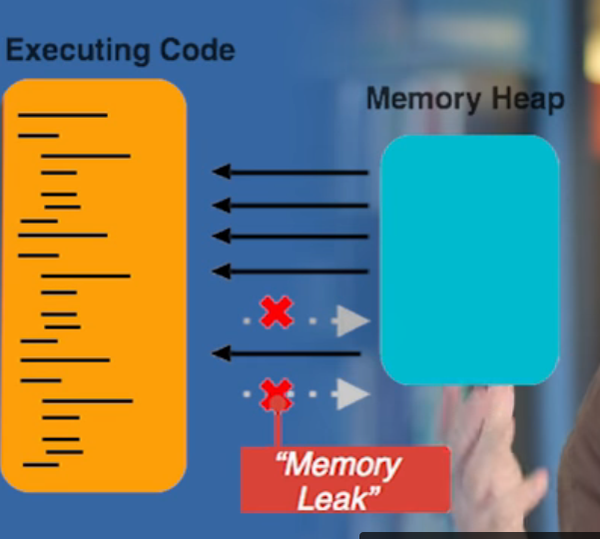
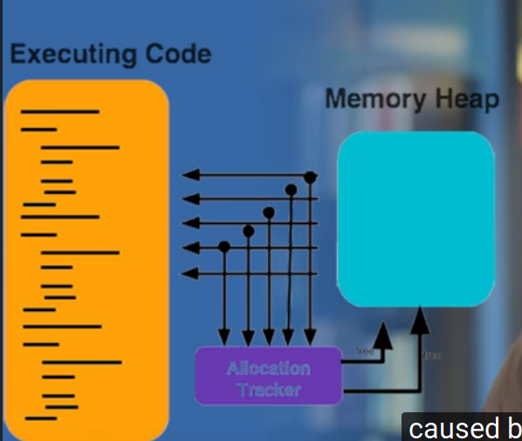
Memory performance
Notes:
What is memory leak?
Typical reasons?

Slide 9
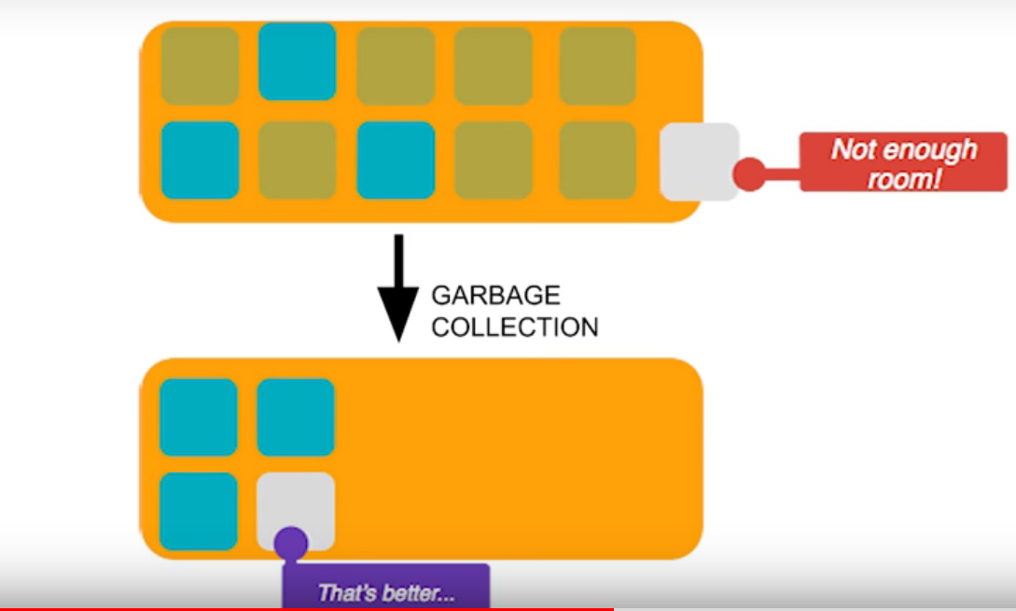
Memory unavailable
Notes:
What is garbage collection?

Slide 10
About me
Twitter: @geekanamika
LinkedIn: https://www.linkedin.com/in/geekanamika/
Medium:https://medium.com/@anamikatripathi1601/
Github: https://github.com/geekanamika
Notes:
1. Android experience
2. Prior performance knowledge if yes which
3. applied it?
Performance playlist: https://www.youtube.com/playlist?list=PLWz5rJ2EKKc9CBxr3BVjPTPoDPLdPIFCE
Udacity course: https://in.udacity.com/course/android-performance--ud825

Slide 11
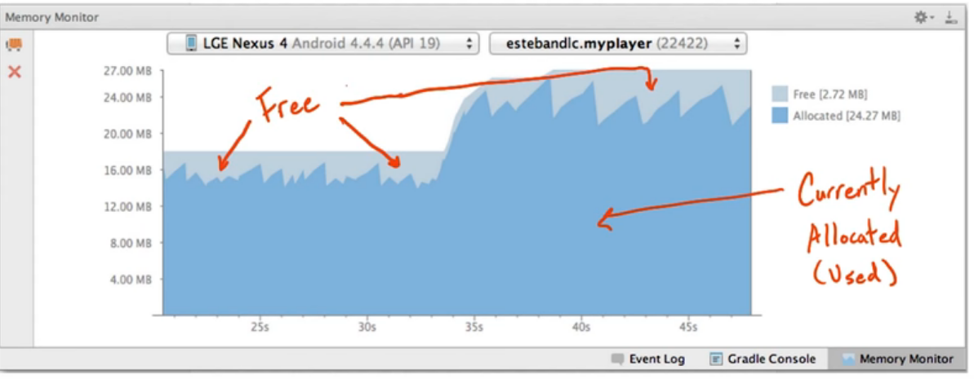
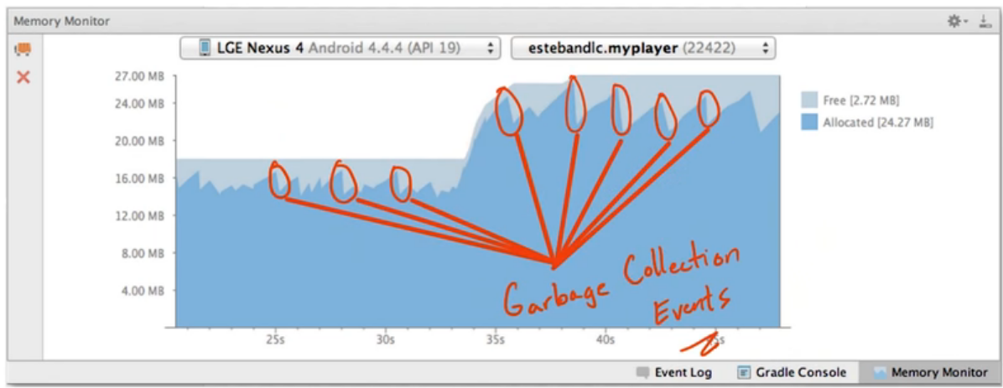
Memory monitor
Memory monitor view
Allocated and free memory increases as per demand
Healthy garbage collection example

Slide 12
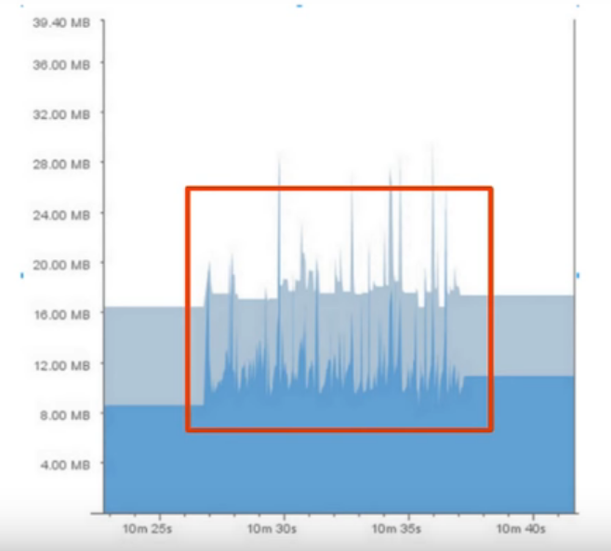
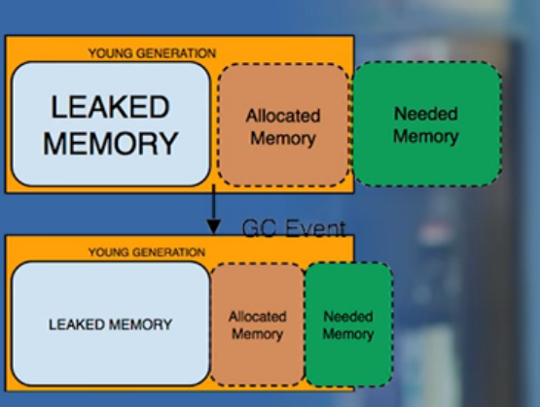
Bad memory allocation ex

Slide 13
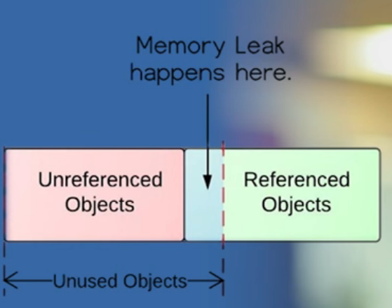
Memory leaks
Memory leaks are objects which application is no longer using but GC fails to recognize them.
Result is permanent in heap which never gets freed & take the valuable space.
https://developer.android.com/studio/profile/memory-profiler.html
Tip : Track the object life & clean up the reference when no longer required.
If we allocate a high number of objects in a small period of time like inner for look or in onDraw() functions , We’re asking for alot of sudden memory which eventually will trigger GC & process becomes slower. Solution : Try to find these instances & keep them out of loop if they’re going to be need many times.

Slide 14
Memory profiler

Slide 15
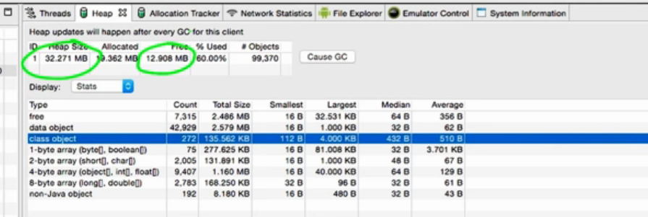
Heapviewer ss

Slide 16
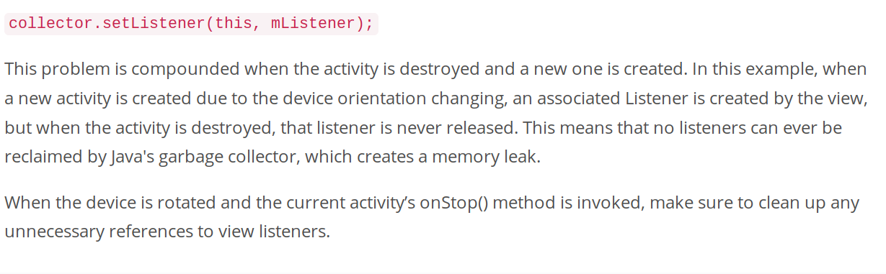
Avoid memory leaks tips

Slide 17
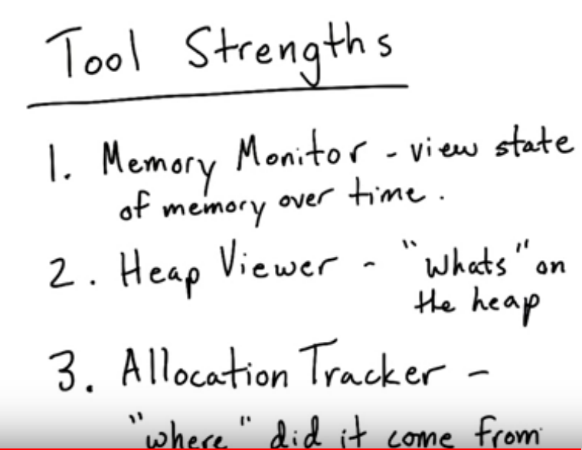
Memory tools
Memory monitor
Heap viewer
Allocation tracker

Slide 18
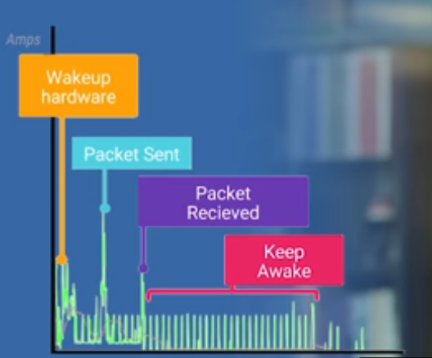
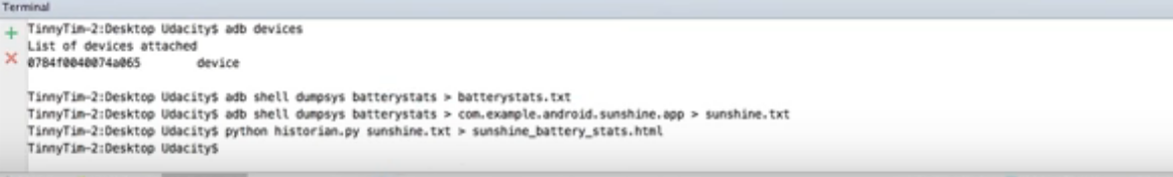
Battery performance
Links
https://github.com/google/battery-historian
https://developer.android.com/studio/profile/battery-historian.html
Download the zip file of battery historian , extract it & check whether device is attached
Adb kill-server for killing the old data
Command to reset battery data gathering from the terminal: adb shell dumpsys batterystats --reset

Slide 19
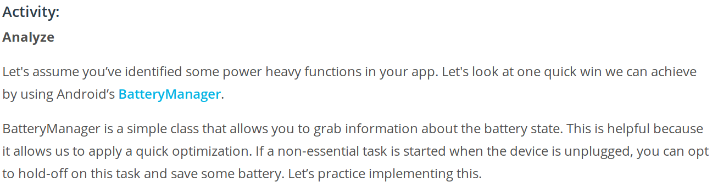
Battery analyze using Battery manager
Battery manager: https://classroom.udacity.com/courses/ud825/lessons/3758168642/concepts/37808385480923

Slide 20
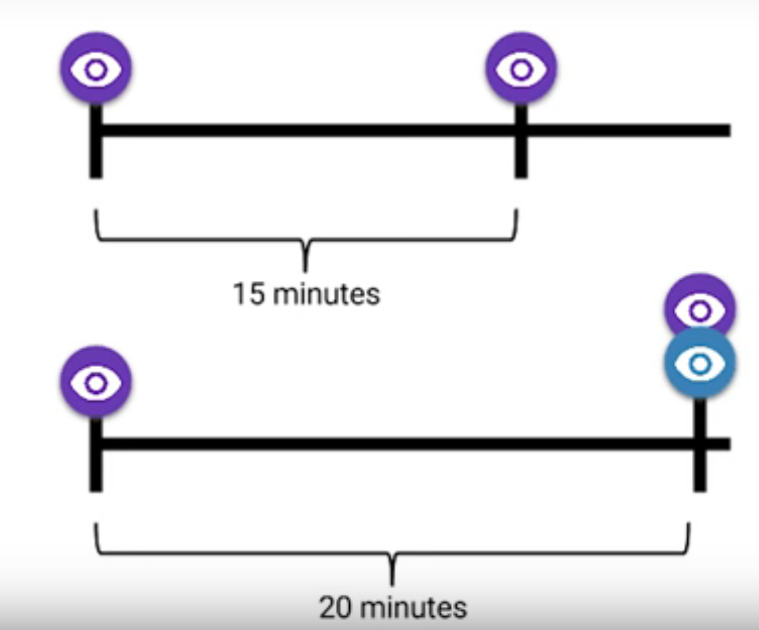

Battery life - Waylock & drain https://www.youtube.com/watch?v=KzSKIpJepUw&feature=youtu.be
Wake up phone PowerManager.wake lock API - This can go horribly wrong.What if app takes 60min instead of 10sec or keep awake forever.
Set the inexact time limt
Use JobSchedur API to make work better
Acquire the wakelock->do work -> Remember to release it.

Slide 21
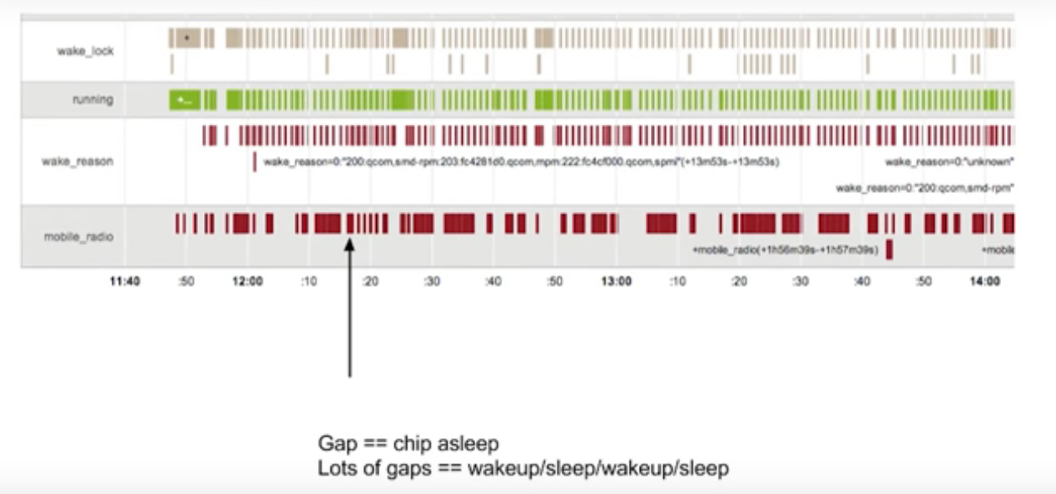
Network connection & Battery Management
Smaller the gaps, more wakeup & it means more battery drain.
https://developer.android.com/reference/android/app/job/JobScheduler.html
https://developer.android.com/reference/android/app/job/JobInfo.Builder.html

Slide 22


Slide 23
Trace View
Select Tools > Android > Android Device Monitor from the main menu.
In monitor , select DDMS & application that needs to be profiled
Click on Three arrows with red button to start profiling and interact with application
Click on same button to stop

Slide 24
Inspect the results of trace view
A timeline pane that describes when each thread enters and exits a method
A profile pane that summarizes the execution of each thread over the period of the trace log
Function in profile pane are already sorted
Use parent/children to detect why it’s called (if it’s not a method written by us)
https://developer.android.com/studio/profile/traceview.html

Slide 25
Batching & caching

Slide 26
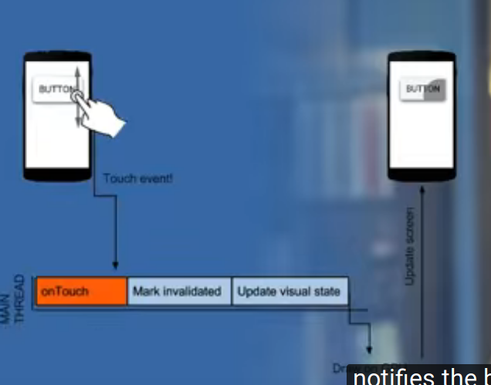
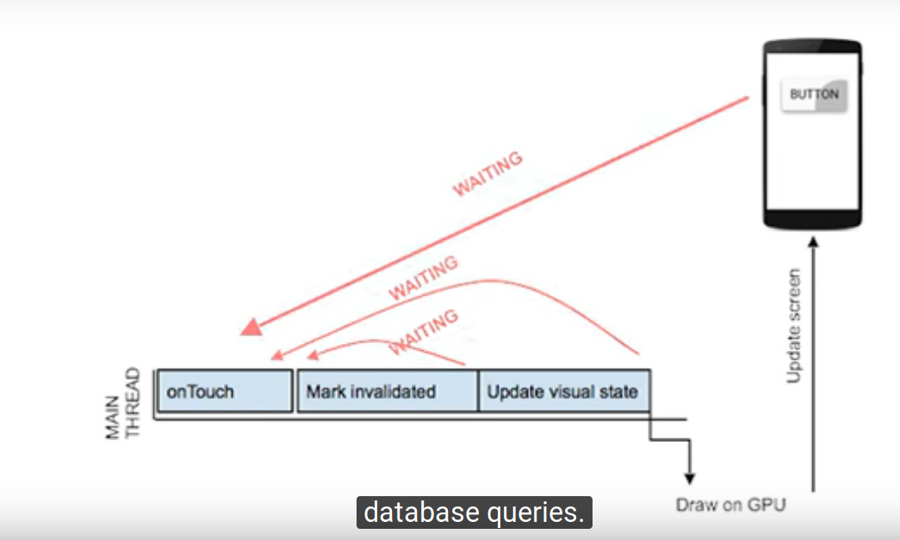
UI Thread

Slide 27
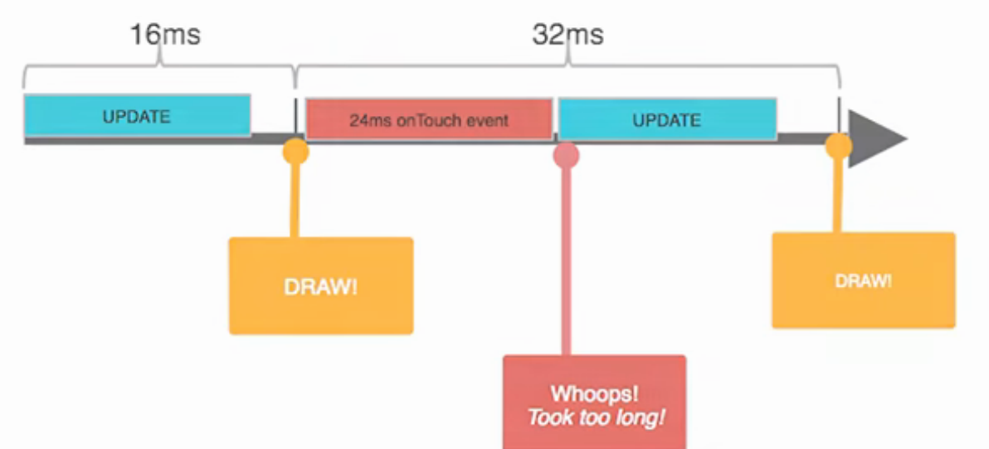
Lagging on UI thread

Slide 28
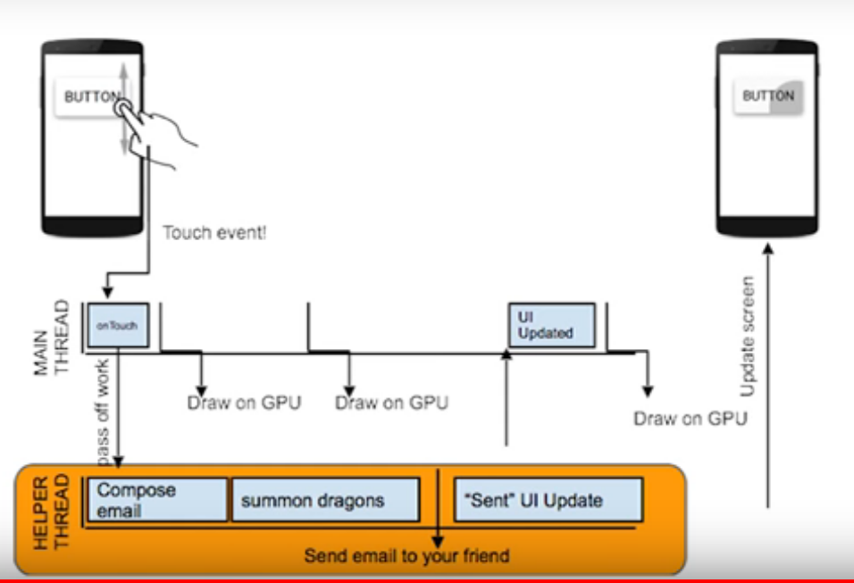
Example to keep work away from UI thread

Slide 29
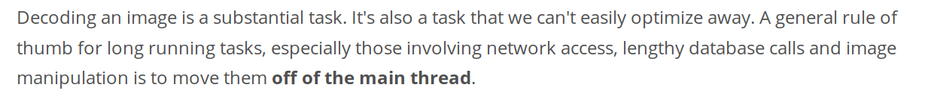
After checking traceview results

Slide 30
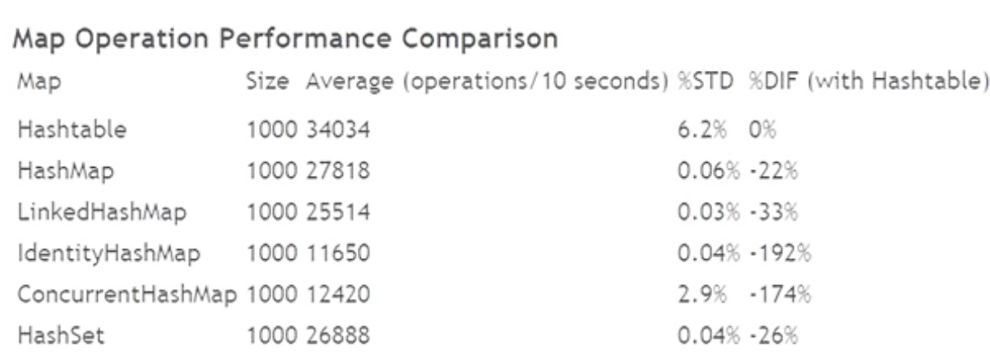
Container performance

Slide 31
Use Systrace to check contrainer performance & optimize it
https://developer.android.com/studio/command-line/systrace.html

